Slide 1
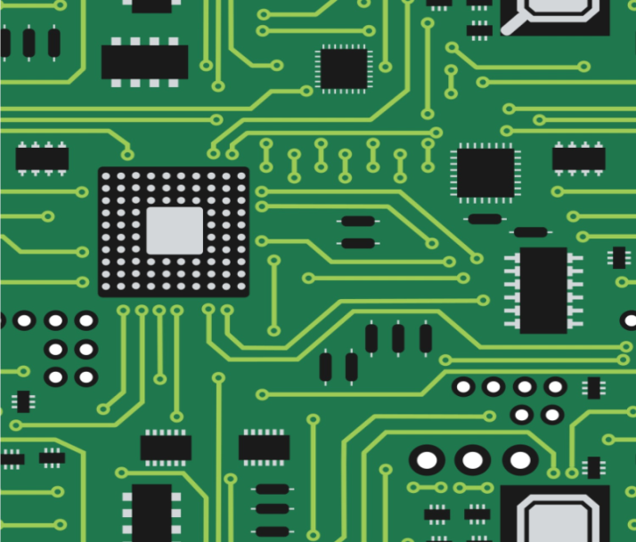
PCB Design & Fabrication

Slide 2
Learn about the various elements of Embedded Hardware and their design principles Refresh knowledge on the basic Analog Electronic components and circuits - Resistor, Capacitor, Diode, Inductor, Transistor etc. and their use in embedded applications Refresh knowledge on the basic Digital Electronic components and circuits Learn about Integrated Circuits (lC’s)
Learning Objective

Slide 3
Schematic is a way of representing the different components (can be an electronic component like resistor, integrated circuit , capacitor, etc. or a mechanical/electromechanical component like push button switch, relay, etc.) involved in a hardware product and how each components are interconnected together. Eagle tool, You can create a schematic design either by hand sketch on a paper or by electronic sketch using and b real electronic circuit out of it to test in the real world
Schematic Design Using Eagle

Slide 4
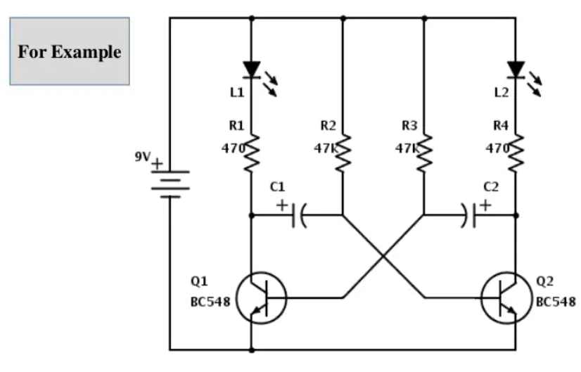
Schematic Design Using Eagle

Slide 5
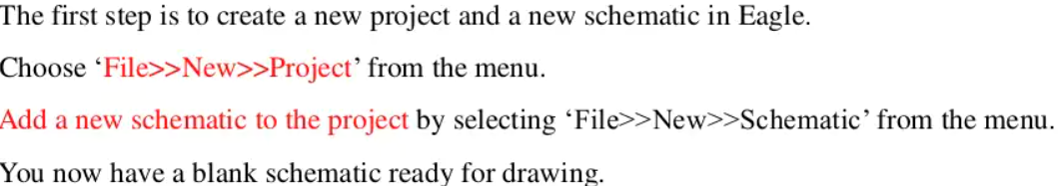
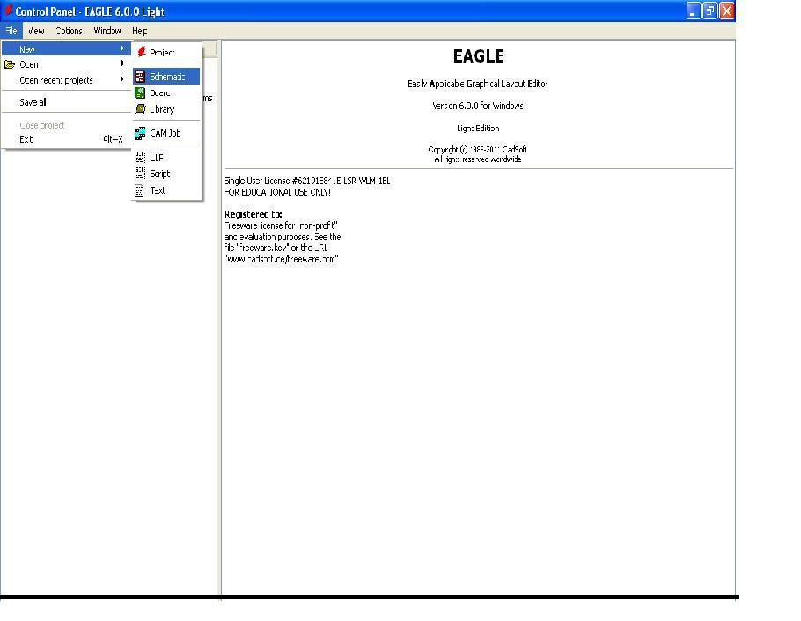

Slide 6
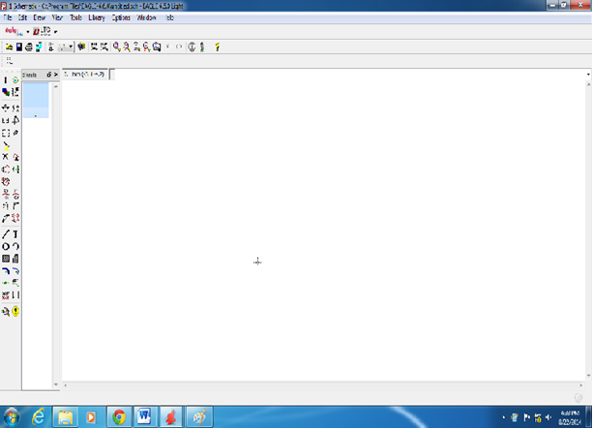
Schematic View

Slide 7
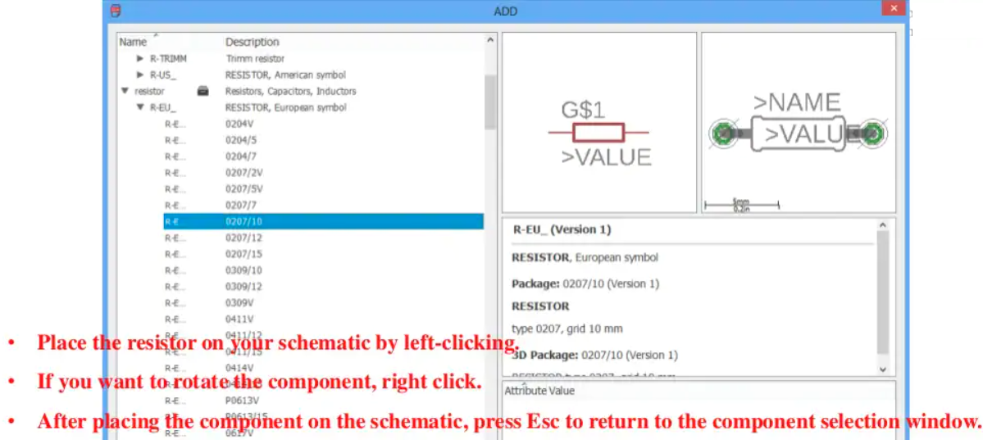

Slide 8
After addition of Component Make Connection Between them by clicking toolbar icon

Slide 9

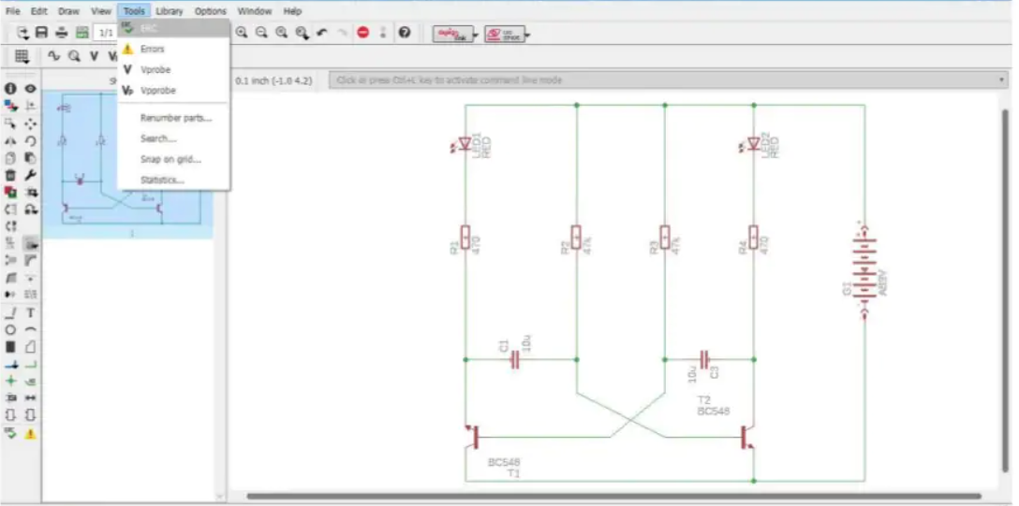

Slide 10

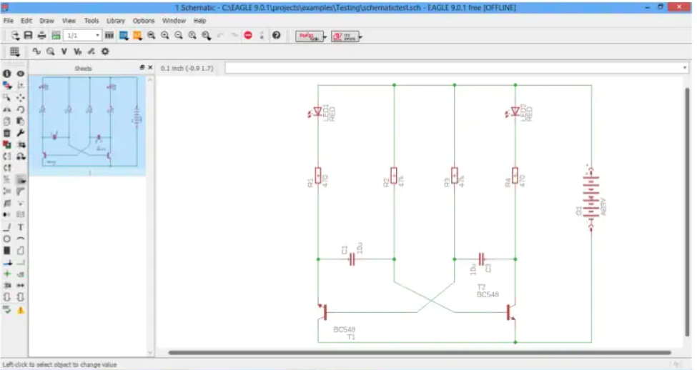

Slide 11

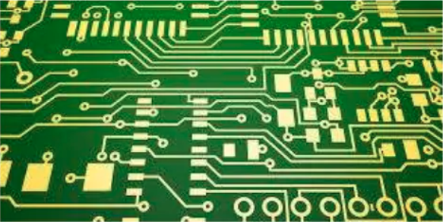

Slide 12


Slide 14
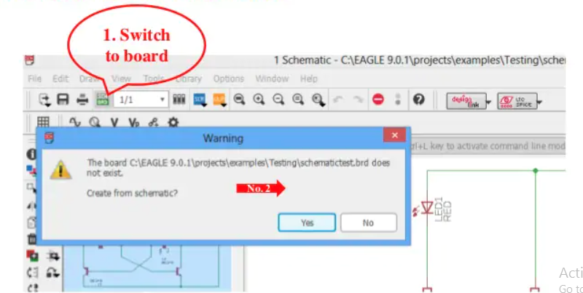

Slide 15
A new window opens which is the PCB layout editor.
The black space is the board area and all the components are at the outside bottom left of the board area.
Now, we need to place the components in to the editor
You can adjust the grid size of the PCB layout editor, if you want.

Slide 16
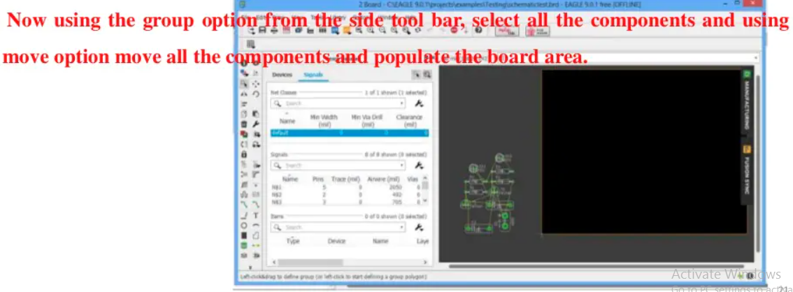

Slide 17
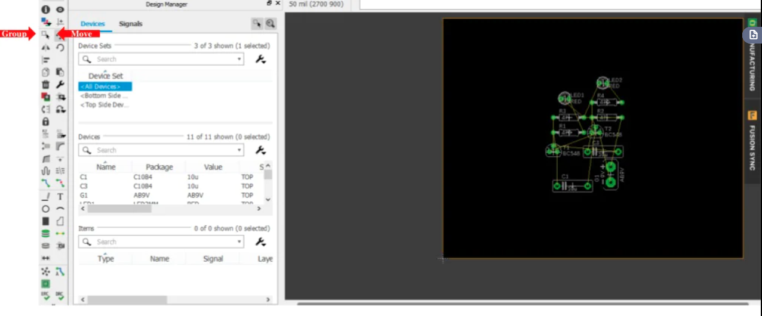

Slide 18
You can see thin yellow wires running between the components.
These wires are called air wires & are representation of connection between components.
When we route the path between components, these air wires will disappear as an indication of successful connection.

Slide 19
Now, it is time to make the connections or trace the printed circuit board (PCB).
For this, we are going to use the Route tool from the side tool bar.
Also set the width of the trace to be routed as your requirement.
Here, I’ve set the trace width to approximately 1mm.
Then, select the signal layer i.e bottom layer, as our PCB is a single sided board.

Slide 20
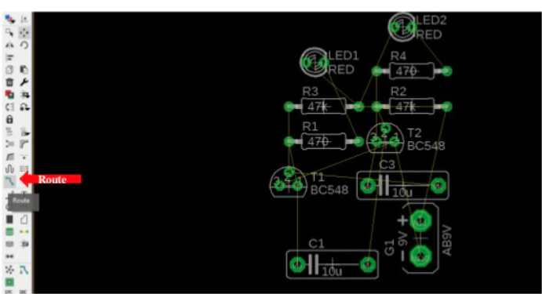
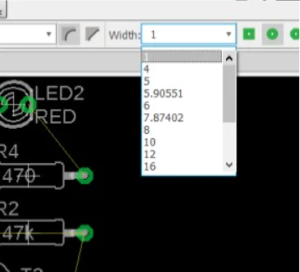

Slide 21
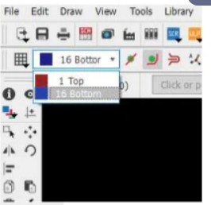
Select Layer

Slide 22
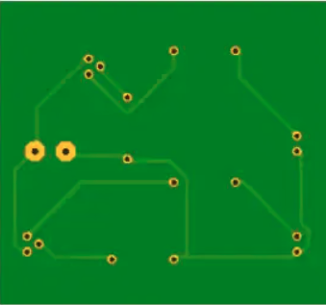
Start routing the traces from pin to pin.
As you progress with routing, the air wires will start disappearing.

Slide 23
PCB FABRICATION PROCESS

Slide 24
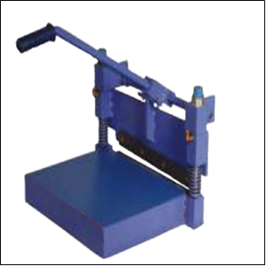
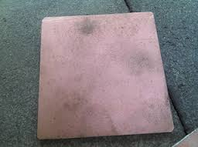
Copper Laminate Cutting
PCB Shearing Machine
Copper Laminate

Slide 25
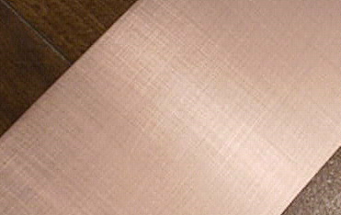
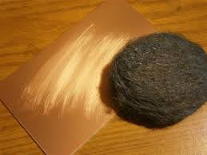
Cleaning the Laminate
PCB before cleaning
PCB after cleaning with scrubber
Clean PCB surface using scrubber

Slide 26
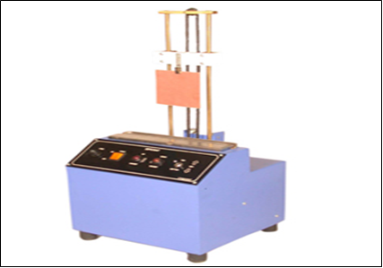
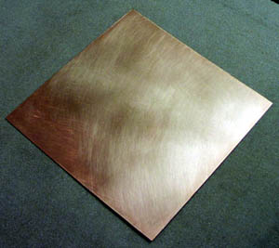
Coating the Laminate
Photo Resist DIP-COATING Machine
Coating PCB with Photoresist solution

Slide 27
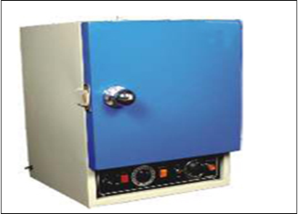
Pre-baking
Proto-cure baking curing oven
Coating PCB with Photoresist solution and Dry it in proto-cure Oven

Slide 28
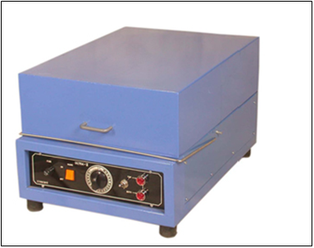
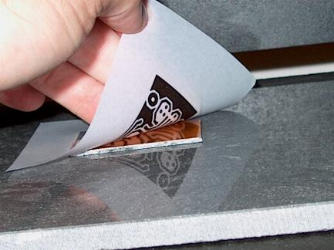
Exposure
Double sided UV Exposure unit
In UV exposure keep layout on photoresist Coated PCB

Slide 29
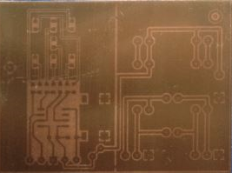
Development
UV exposed PCB board after developing Stage

Slide 30
Wash Laminate

Slide 31
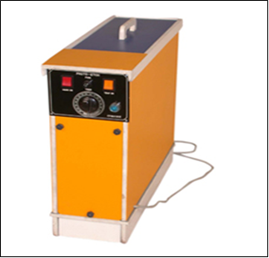
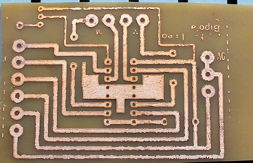
Etching
Proto-Etch Etching Machine
PCB after Etching Process done

Slide 32
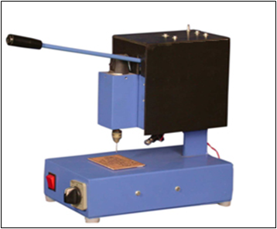
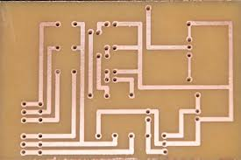
Drilling
PCB Drilling Machine
PCB after Drilling done

Slide 33
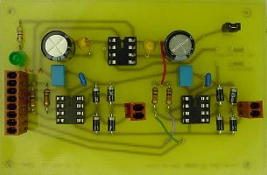
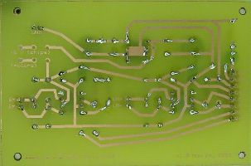
Final PCB
Top View
Bottom View

